Slide 1
Acceptance By Final State, Acceptance By Empty Stack In Flat
SlideMake.com

Slide 2
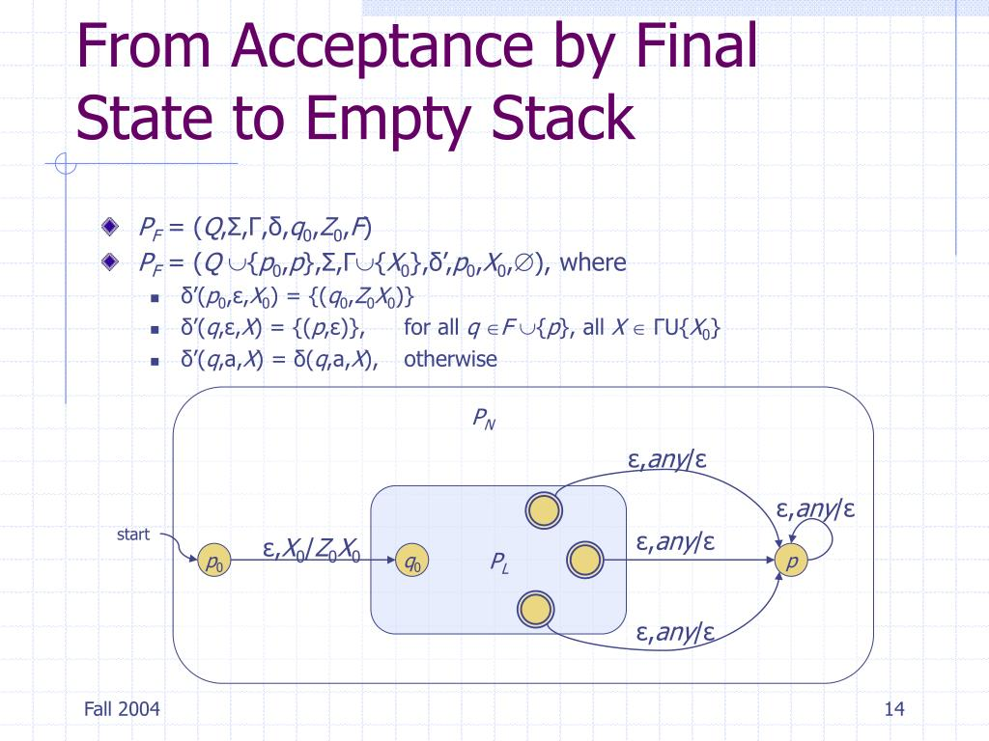
Introduction to Acceptance Methods
Acceptance by final state and acceptance by empty stack are two key methods in automata theory.
These methods are used to define how a pushdown automaton (PDA) recognizes a language.
Understanding these concepts is essential for studying computational theory and formal languages.
1
Notes:
Image source: https://image3.slideserve.com

Slide 3
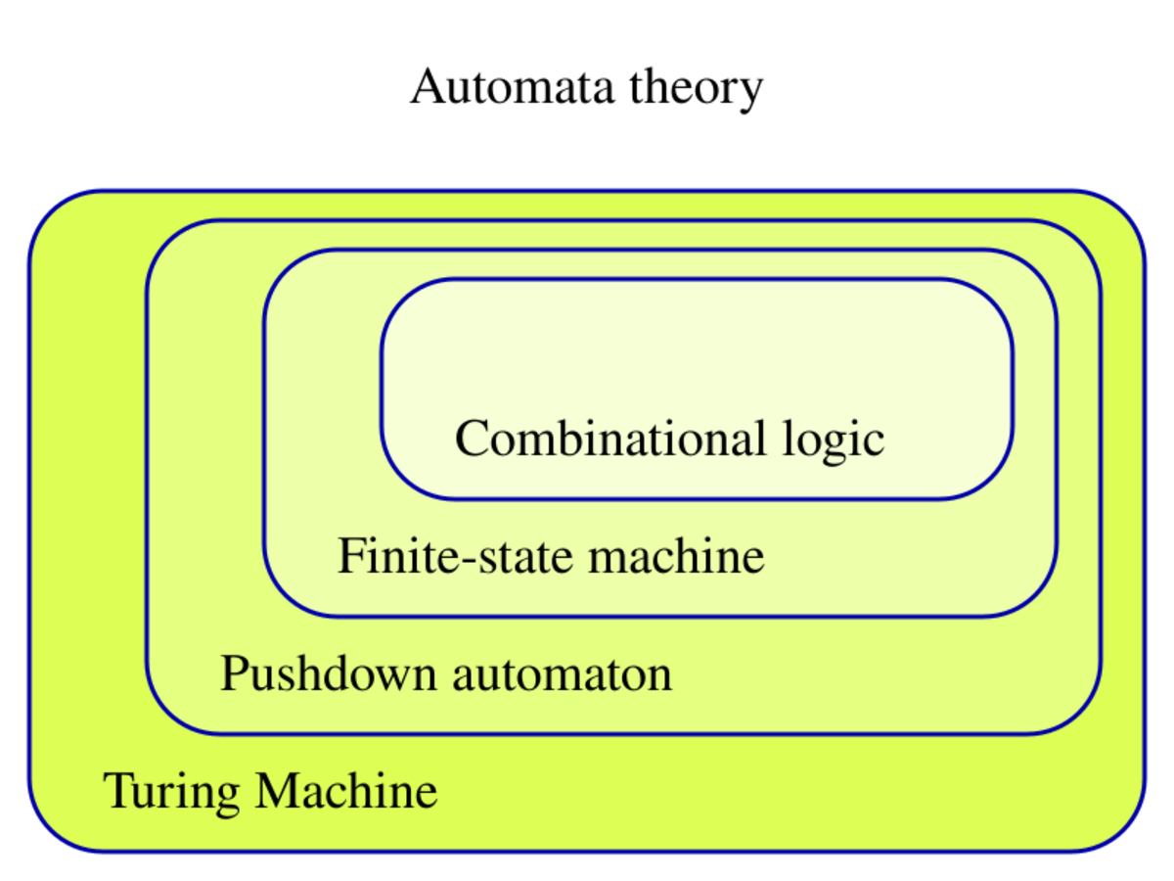
What is a Pushdown Automaton (PDA)?
A pushdown automaton is a type of automaton that utilizes a stack for memory.
It can be deterministic or nondeterministic, affecting its computational power.
PDAs are particularly useful for recognizing context-free languages.
2
Notes:
Image source: https://handwiki.org

Slide 4
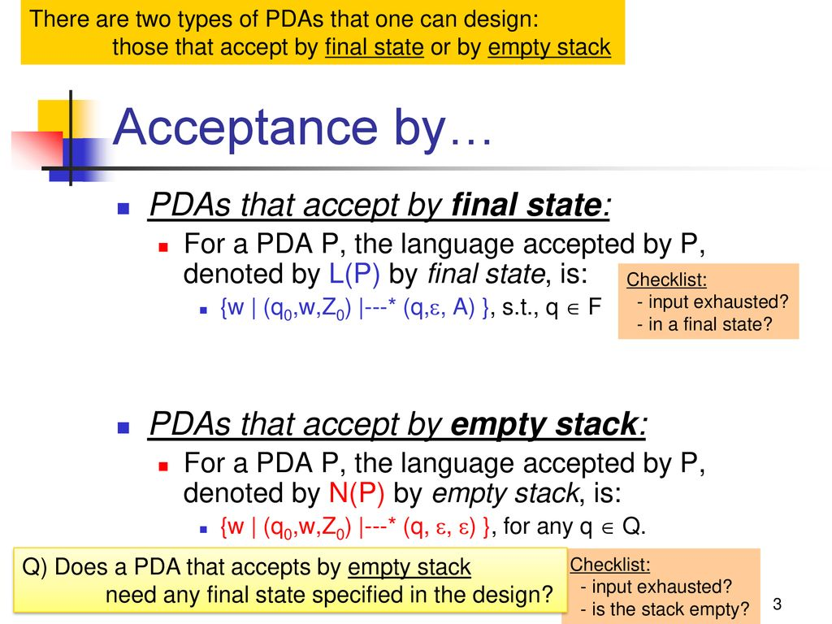
Acceptance by Final State
Acceptance by final state occurs when the PDA reaches a designated final state.
In this method, the input string must be fully processed, and the PDA must end in an accepting state.
This approach is similar to how finite automata accept strings, focusing on state transitions.
3
Notes:
Image source: https://slideplayer.com

Slide 5
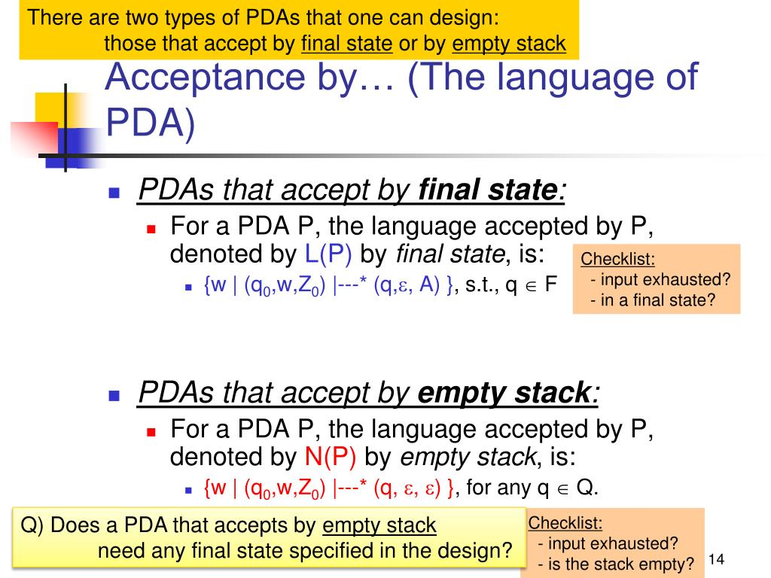
Advantages of Acceptance by Final State
This method simplifies the design of a PDA by focusing on state transitions alone.
It allows for clear definitions of accepted languages, making them easier to analyze.
Many practical applications and algorithms leverage this acceptance method for efficiency.
4
Notes:
Image source: https://image3.slideserve.com

Slide 6
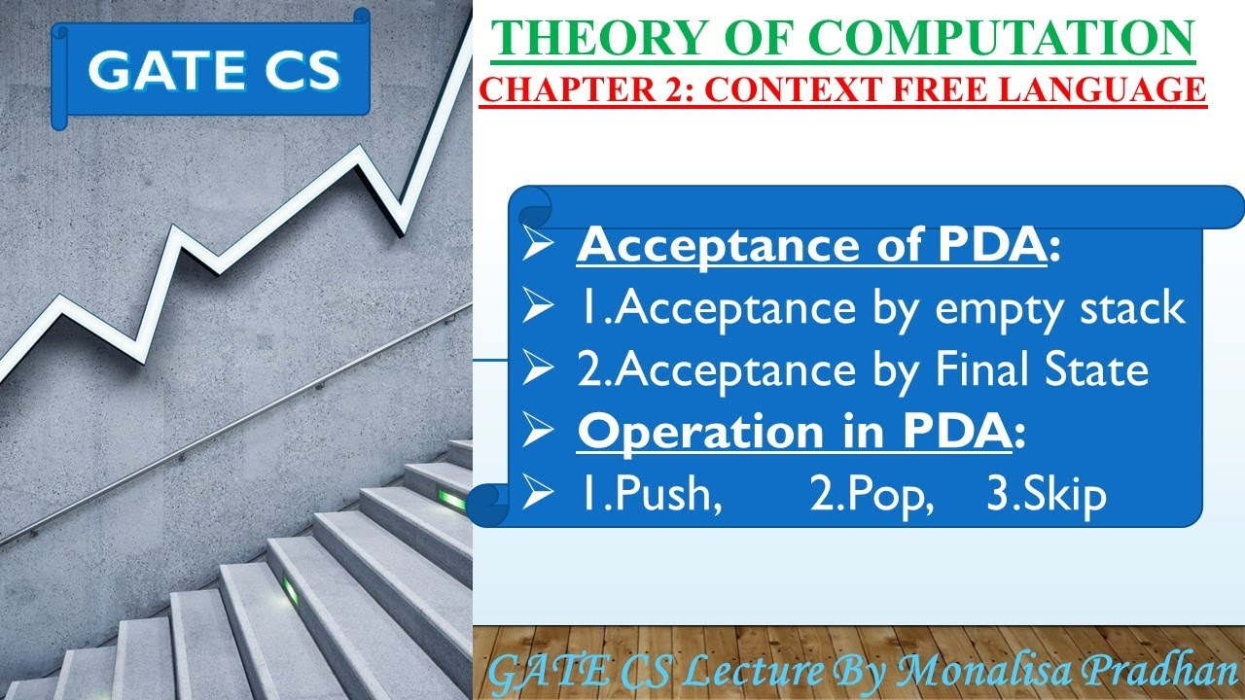
Acceptance by Empty Stack
Acceptance by empty stack occurs when the PDA empties its stack after processing the input.
This method does not require the PDA to reach a final state but instead focuses on the stack content.
It is particularly useful for languages where the stack plays a critical role in acceptance.
5
Notes:
Image source: https://i.ytimg.com

Slide 7
Advantages of Acceptance by Empty Stack
This approach provides a different perspective on acceptance, focusing on stack behavior.
It can accommodate certain types of languages that may not be easily recognized by final states.
Acceptance by empty stack often results in more flexibility in PDA design and implementation.
6
Notes:
Image source: https://www.researchgate.net

Slide 8
Comparison of Both Methods
Both acceptance methods can be used to define the same class of languages, specifically context-free languages.
The choice between final state and empty stack acceptance often depends on the specific application or problem domain.
Understanding both methods enhances a deeper comprehension of the capabilities of PDAs.
7
Notes:
Image source: https://pynative.com

Slide 9
Conclusion and Implications
Mastery of acceptance by final state and empty stack is crucial for computer science students and professionals.
These concepts pave the way for advanced studies in formal languages and compiler design.
Grasping these acceptance methods can lead to innovative solutions in automata theory and beyond.
8
Notes:
Image source: https://image3.slideserve.com

